Slide 1

CSCI203 - Algorithms and Data Structures
Tutorial / Laboratory 1b
sjapit@uow.edu.au
14 July 2020

Slide 2
Algorithm efficiency - Revisit
$$Show that f\left(n\right)=3n^{2}+5∈O\left(n^{2}\right)$$
15 minutes to discuss.

Slide 3
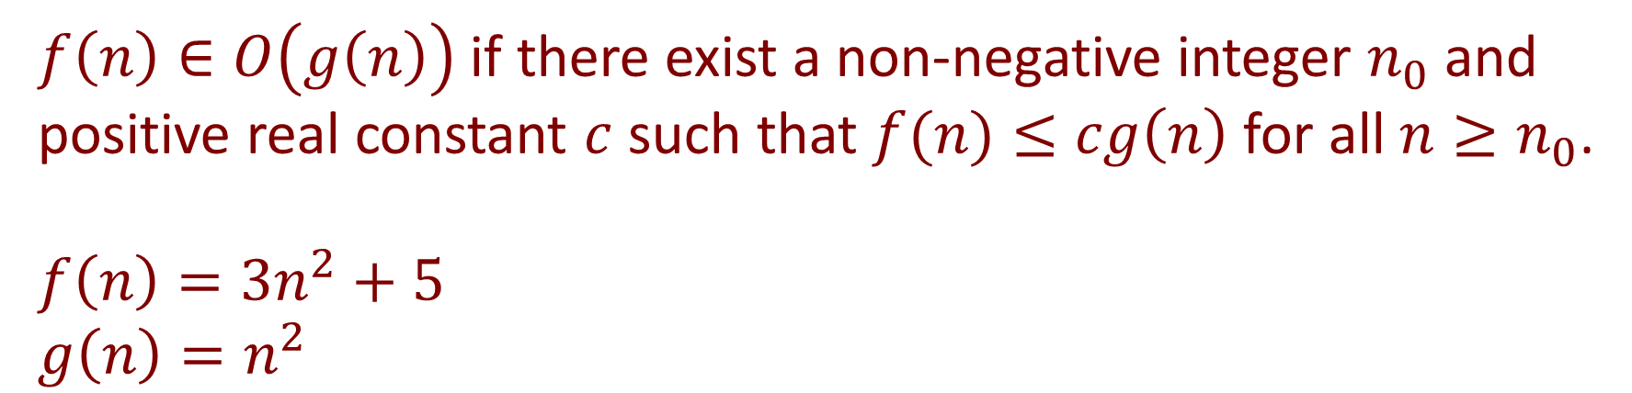
Algorithm efficiency - Revisit
$$Show that f\left(n\right)=3n^{2}+5∈O\left(n^{2}\right)$$
Method 1: (formal)
$f\left(n\right)∈O\left(g\left(n\right)\right)$ if there exist a non-negative integer $n_{0}$ and positive real constant $c$ such that $f(n)≤cg\left(n\right)$ for all $n≥n_{0}$.
$$f\left(n\right)=3n^{2}+5$$
$$g\left(n\right)=n^{2}$$

Slide 4

Algorithm efficiency - Revisit
Method 1: (formal)
$$Thus, 3n^{2}+5≤cn^{2}$$
$$5≤cn^{2}−3n^{2}$$
$$5≤\left(c−3\right)n^{2}$$
$$\frac{5}{\left(c−3\right)}≤n^{2} ⇒n≥\sqrt{\frac{5}{c−3}}$$
For the above to be true, $c=4$and $n≈2.24 or n=3$.

Slide 5
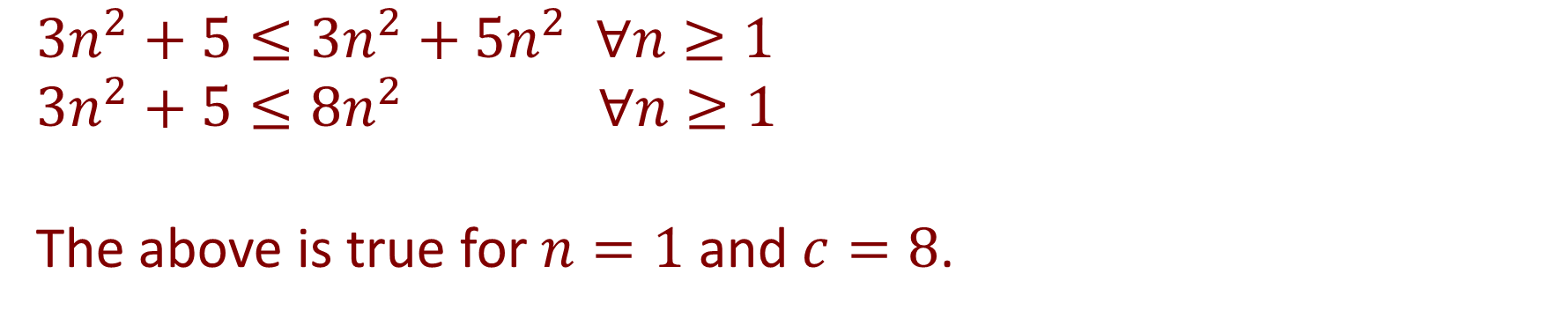
Algorithm efficiency - Revisit
Method 2: (informal)
$$3n^{2}+5≤3n^{2}+5n^{2} ∀n≥1$$
$$3n^{2}+5≤8n^{2} ∀n≥1$$
The above is true for $n=1$ and $c=8$.

Slide 6

Algorithm efficiency - Revisit
Through method 1, we have
$$3n2 + 5 ≤ 4n2 for n ≥ 2.24 or n ≥ 3.$$
Through method 2, we have
$$3n2 + 5 ≤ 8n2 for n ≥ 1.$$

Slide 7
Algorithm efficiency - Revisit
8n²
4n²
1.0
3n²+5
2.24

Slide 8
Algorithm efficiency - Revisit
$$Show that 3\lg{n}+\lg\left(\lg{n}\right)∈O\left(\lg{n}\right)$$
15 minutes to discuss.

Slide 9
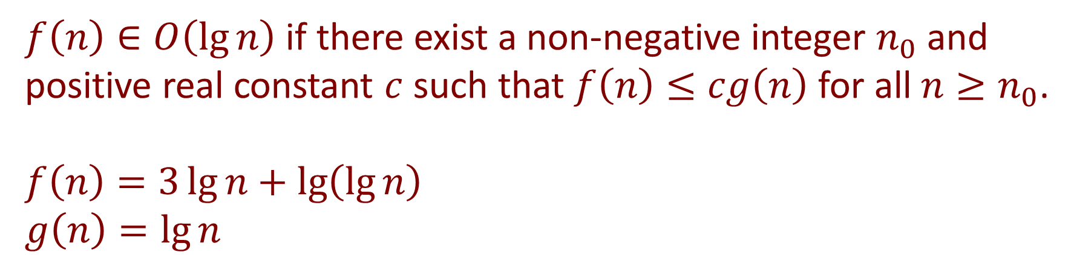
Algorithm efficiency - Revisit
$$Show that 3\lg{n}+\lg\left(\lg{n}\right)∈O\left(\lg{n}\right)$$
$f\left(n\right)∈O\left(\lg{n}\right)$ if there exist a non-negative integer $n_{0}$ and positive real constant $c$ such that $f\left(n\right)≤cg\left(n\right)$ for all $n≥n_{0}$.
$$f\left(n\right)=3\lg{n}+\lg\left(\lg{n}\right)$$
$$g\left(n\right)=\lg{n}$$

Slide 10

Algorithm efficiency - Revisit
$$Thus 3\lg{n}+\lg\left(\lg{n}\right)≤c\lg{n}$$
$$\lg\left(\lg{n}\right)≤c\lg{n}−3\lg{n}$$
$$\lg\left(\lg{n}\right)≤\left(c−3\right)\lg{n}$$
$$\frac{\lg\left(\lg{n}\right)}{\lg{n}}≤\left(c−3\right)$$
For the above to be true, $c=4$ and $n=2$.
(Note: $\lg{1=0}$)

Slide 11
Algorithm efficiency - Revisit
3lg n + lg(lg n)

Slide 12
Algorithm efficiency
Determine the big O running time of the method myMethod() by counting the approximate number of operations it performs. Show all details of your answer.
static int myMethod(int n) {
int sum = 0;
for (int i = 1; i <= n; i = i * 2)
sum = sum + i + helper(i);
return sum;
}
static int helper(int n) {
int sum = 0;
for (int i = 1; i <= n; i++)
sum = sum + i;
return sum;
}

Slide 13

10 minutes to discuss

Slide 14
Algorithm efficiency
We first determine the running time of the method helper():
static int helper(int n) {
int sum = 0;
for (int i = 1; i <= n; i++)
sum = sum + i;
return sum;
}
1
n
n
Total = 1 + 2n + 1
= 2n+2
O(n)
1

Slide 15

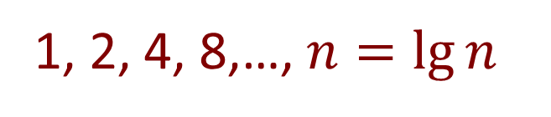
Algorithm efficiency
Next, we determine the running time for the method myMethod():
static int myMethod(int n) {
int sum = 0;
for (int i = 1; i <= n; i = i * 2)
sum = sum + i + helper(i);
return sum;
}
1
1, 2, 4, 8,…, $n=lg⁡n$
$$(lg⁡n) (n) = n lg⁡n$$
1
Total = 1 + lg n + n lg n + 1
= n lg n + lg n + 2 or (n+1) lg n + 2 O(n lg n)

Slide 16
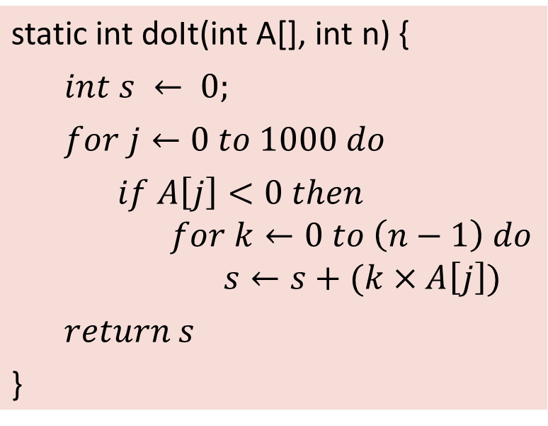
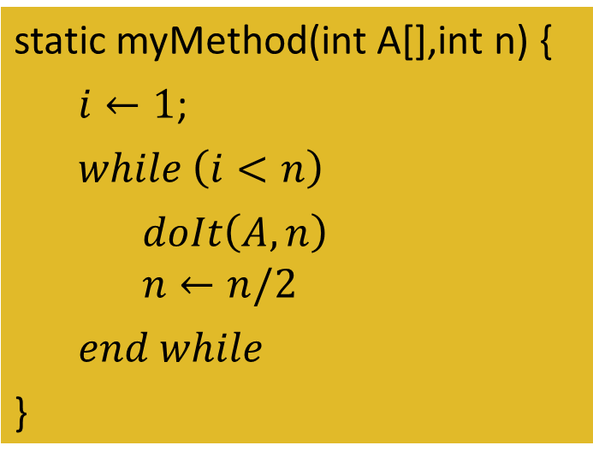
Algorithm efficiency
Give the best asymptotic (Big-Oh) characterization of the worst-case and the best-case time complexity of the algorithm myMethod(A,n).
static int doIt(int A[], int n) {
$$int s ← 0;$$
$$for j←0 to 1000 do$$
$$if A\left[j\right]<0 then$$ $$for k←0 to \left(n−1\right) do$$ $$s←s+(k×A\left[j\right])$$
$$return s$$
}
static myMethod(int A[],int n) {
$i←1$;
$$while \left(i<n\right)$$
$$doIt\left(A,n\right)$$ $$n←n/2$$
$$end while$$
}

Slide 17

15 minutes to discuss

Slide 18

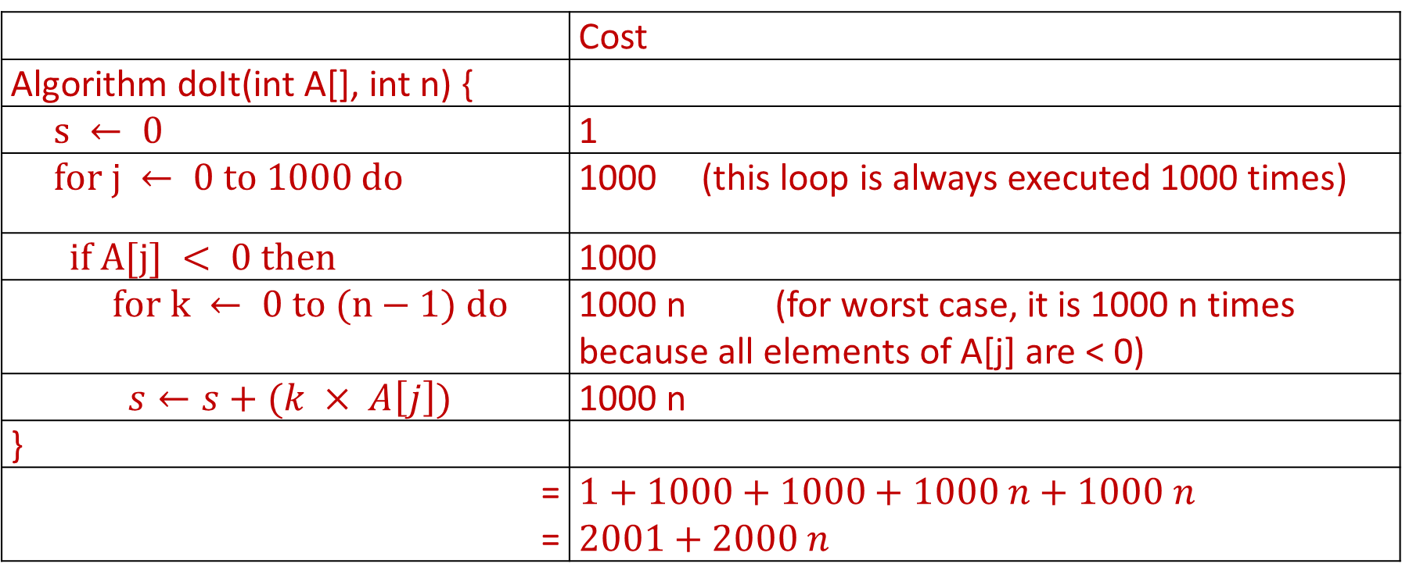
First we evaluate the worst case complexity of the algorithms doIt():
 | Cost
Algorithm doIt(int A[], int n) {
$s ← 0$ | 1
$for j ← 0 to 1000 do$ | 1000 (this loop is always executed 1000 times)
$if A[j] < 0 then$ | 1000
$for k ← 0 to (n−1) do$ | 1000 n (for worst case, it is 1000 n times because all elements of A[j] are < 0)
$s←s+(k × A\left[j\right])$ | 1000 n
}
= = | $1+1000+1000+1000 n+1000 n$ $2001+2000 n$
The worst-case efficiency of doIt is $O(n)$

Slide 19

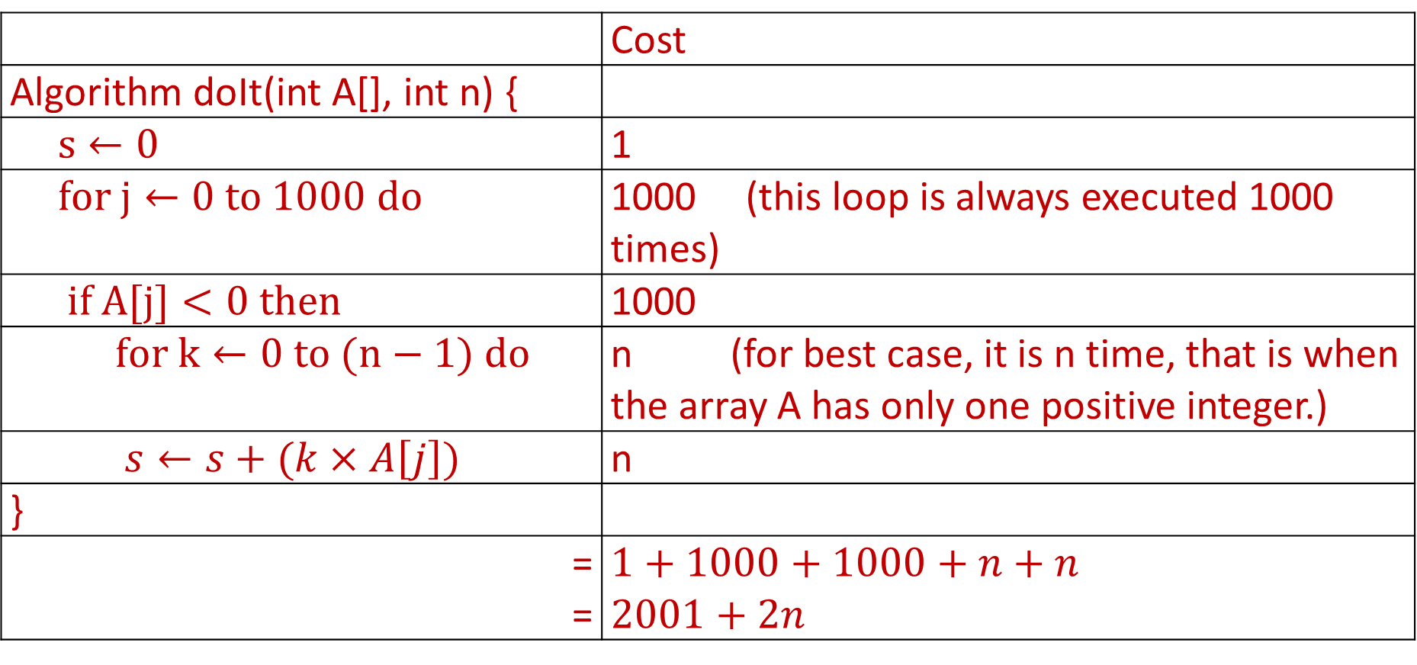
Next, we evaluate the best case complexity of the algorithms doIt():
 | Cost
Algorithm doIt(int A[], int n) {
$s←0$ | 1
$for j←0 to 1000 do$ | 1000 (this loop is always executed 1000 times)
$if A[j]<0 then$ | 1000
$for k←0 to (n−1) do$ | n (for best case, it is n time, that is when the array A has only one positive integer.)
$s←s+(k×A\left[j\right])$ | n
}
= = | $1+1000+1000+n+n$ $2001+2n$
The best-case efficiency of doIt is $O\left(n\right).$

Slide 20
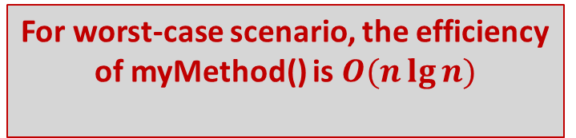
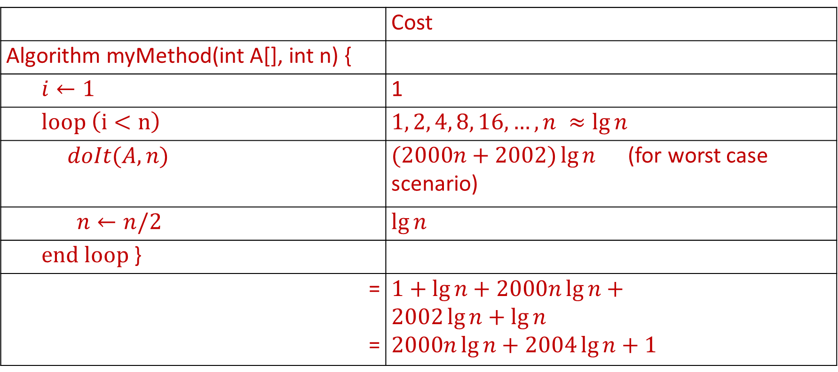
Since the algorithm myMethod() calls the algorithm doIT() within a loop, we evaluate the complexity of the algorithm myMethod() as follow:
 | Cost
Algorithm myMethod(int A[], int n) {
$i←1$ | 1
$loop \left(i<n\right)$ | $1, 2, 4, 8, 16, …, n ≈\lg{n}$
$$doIt(A,n)$$ | $(2000n+2002)\lg{n}$ (for worst case scenario)
$n←n/2$ | $\lg{n}$
$end loop$ }
= = | $$1+lg{n}+2000n\lg{n}+$$ $$2002\lg{n+\lg{n}}$$ $$2000n\lg{n+2004\lg{n+1}}$$
For worst-case scenario, the efficiency of myMethod() is $O(n\lg{n)}$

Slide 21
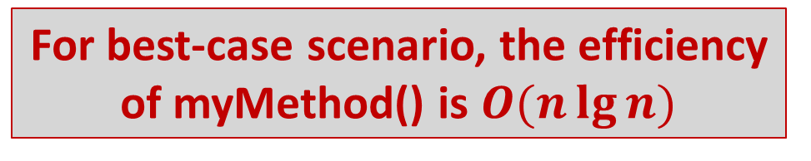
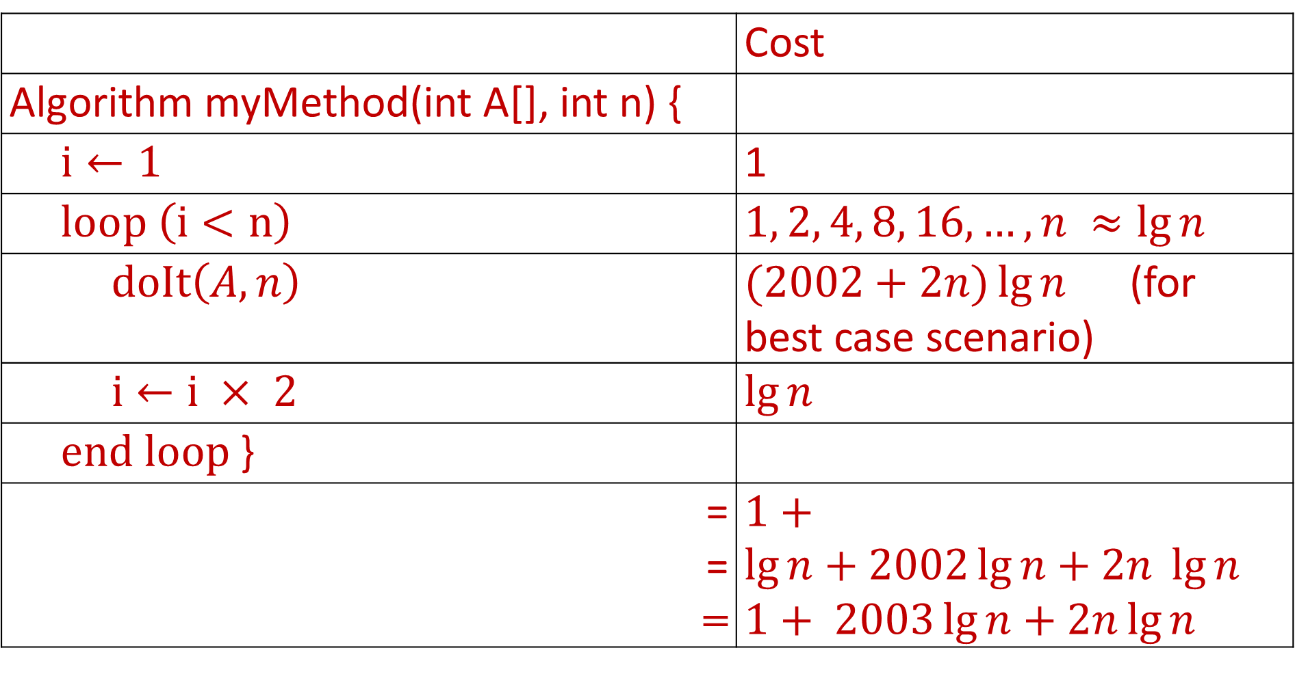
 | Cost
Algorithm myMethod(int A[], int n) {
$i←1$ | 1
$loop \left(i<n\right)$ | $1, 2, 4, 8, 16, …, n ≈\lg{n}$
$doIt\left(A,n\right)$ | $(2002+2n)\lg{n}$ (for best case scenario)
$i←i × 2$ | $\lg{n}$
$end loop$ }
= = = | $1+\lg{n+2002\lg{n+2n \lg{n}}}$ $1+ 2003\lg{n+2n\lg{n}}$
For best-case scenario, the efficiency of myMethod() is $O(n\lg{n)}$

Slide 22


Recursion

Slide 23
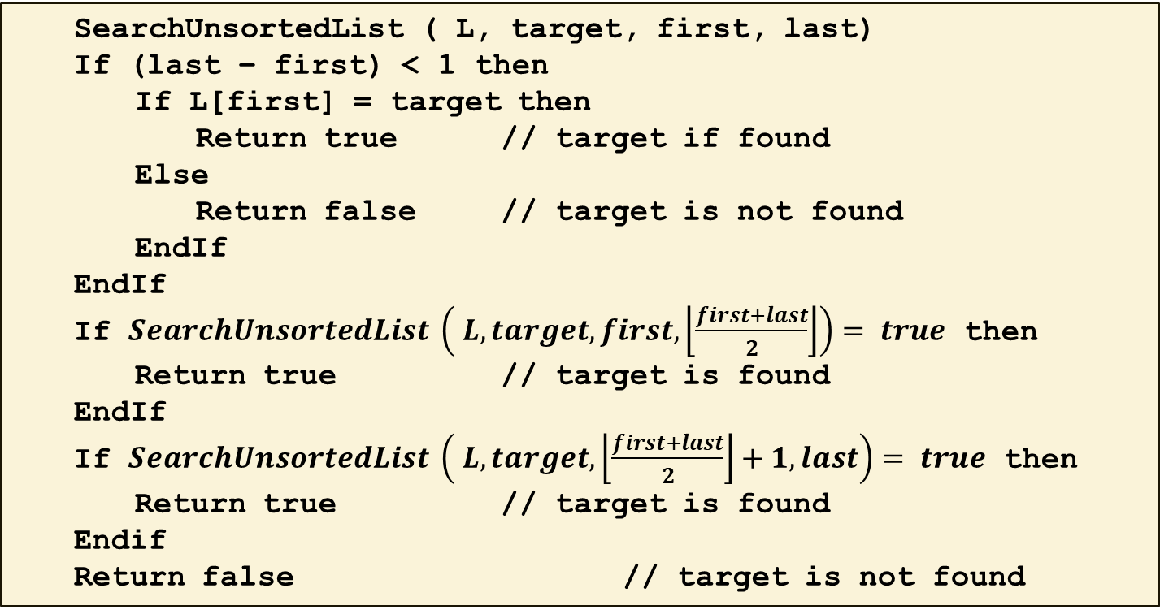
Your lecturer is a funny guy; given an unsorted list of numbers, he will use the following recursive search algorithm to do the search:
SearchUnsortedList ( L, target, first, last)
If (last – first) < 1 then
If L[first] = target then
Return true // target if found
Else
Return false // target is not found
EndIf
EndIf
If $SearchUnsortedList \left( L, target, first, \left\lfloor \frac{first+last}{2}\right\rfloor \right)= true$ then
Return true // target is found
EndIf
If $SearchUnsortedList \left( L, target, \left\lfloor \frac{first+last}{2}\right\rfloor +1, last\right)= true$ then
Return true // target is found
Endif
Return false // target is not found

Slide 24
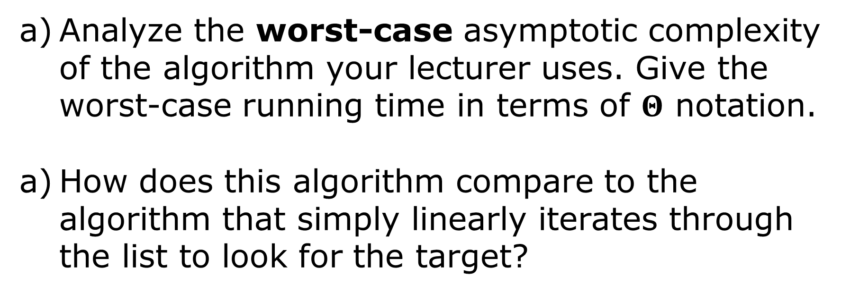
Analyze the worst-case asymptotic complexity of the algorithm your lecturer uses. Give the worst-case running time in terms of $Θ$ notation.
How does this algorithm compare to the algorithm that simply linearly iterates through the list to look for the target?

Slide 25
20 minutes to discuss

Slide 26
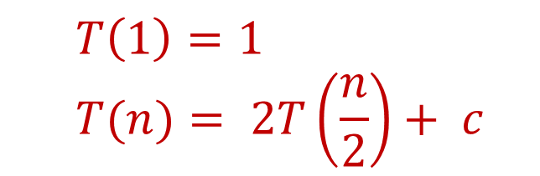
The algorithm is given an array L of n unsorted numbers and a target number. The first ‘if’ statement will take constant time since it will return a true if a target is found otherwise it will return false; we call this time component c.
The next two ‘if’ statements will recursively call SearchUnsortedList on inputs of size n/2. Hence the worst-case asymptotic complexity is
$$T\left(1\right)=1$$
$$T(n)= 2T\left(\frac{n}{2}\right)+ c$$

Slide 27
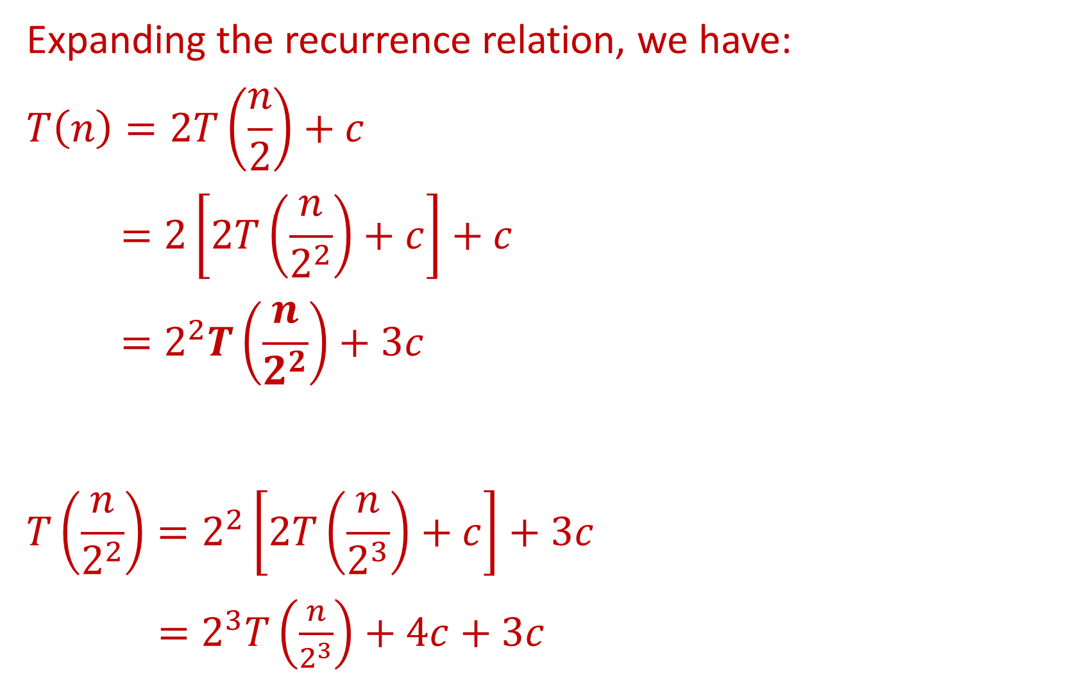
Expanding the recurrence relation, we have:
$$T\left(n\right)=2T\left(\frac{n}{2}\right)+c$$
$$=2\left[2T\left(\frac{n}{2^{2}}\right)+c\right]+c$$
$$=2^{2}T\left(\frac{n}{2^{2}}\right)+3c$$
$$T\left(\frac{n}{2^{2}}\right)=2^{2}\left[2T\left(\frac{n}{2^{3}}\right)+c\right]+3c$$
$=2^{3}T\left(\frac{n}{2^{3}}\right)+4c+3c$

Slide 28
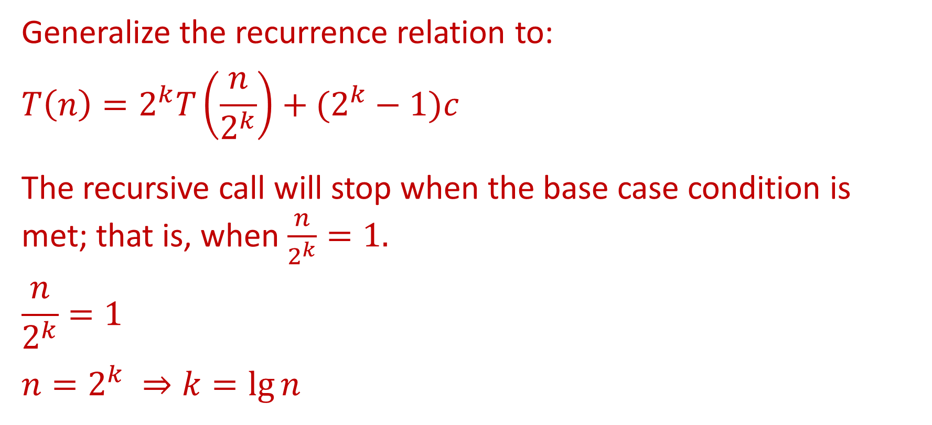
Generalize the recurrence relation to:
$$T\left(n\right)=2^{k}T\left(\frac{n}{2^{k}}\right)+(2^{k}−1)c$$
The recursive call will stop when the base case condition is met; that is, when $\frac{n}{2^{k}}=1.$
$$\frac{n}{2^{k}}=1$$
$$n=2^{k} ⇒k=\lg{n}$$

Slide 29
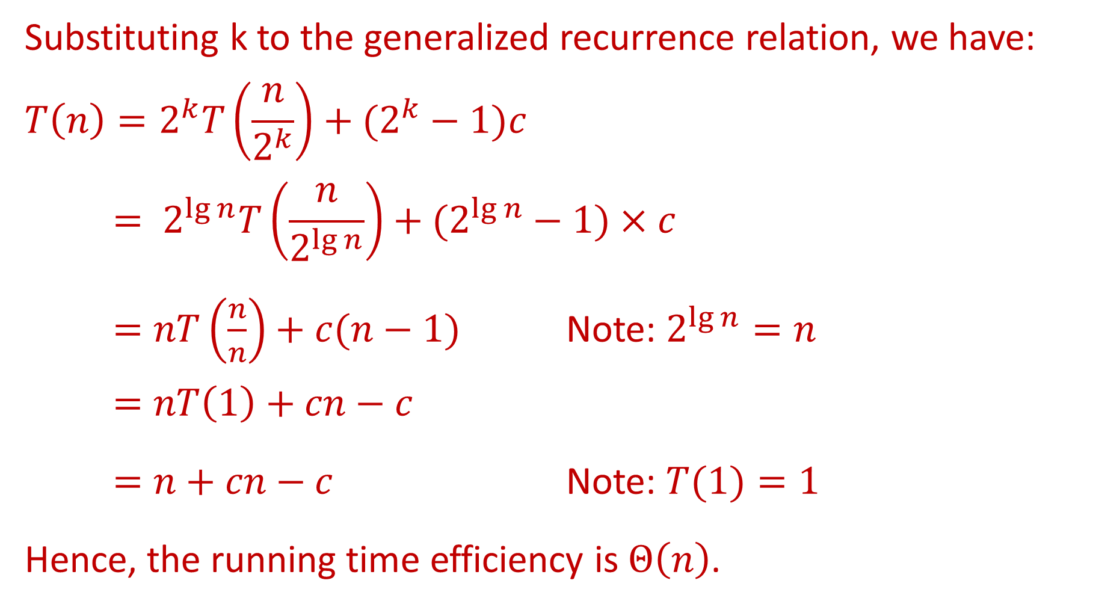
Substituting k to the generalized recurrence relation, we have:
$$T\left(n\right)=2^{k}T\left(\frac{n}{2^{k}}\right)+(2^{k}−1)c$$
$$= 2^{\lg{n}}T\left(\frac{n}{2^{\lg{n}}}\right)+(2^{\lg{n}}−1)×c$$
$=nT\left(\frac{n}{n}\right)+c(n−1)$ Note: $2^{\lg{n}}=n$
$$=nT\left(1\right)+cn−c$$
$=n+cn−c$ Note: $T(1)=1$
Hence, the running time efficiency is $Θ\left(n\right)$.

Slide 30
The worst-case asymptotic complexity of this algorithm is the same as the algorithm that linearly iterates through the list.

Slide 31
Algorithms
Write an algorithm that reverse the array A[1],…,A[n].
What is the best case and worst case of your algorithm?

Slide 32
Algorithms
The algorithm for finding the maximum element of an array is as following:
Determine the number of times that the statement “currentMax = A[i]” will be executed in the best case and in the worst case.
Function arrayMax( A[1..n] )
currentMax = A[1]
For i = 2 to n do
if A[i] > currentMax then
currentMax = A[i]
Return currentMax

Slide 33
Algorithm
The best case and worst case of the algorithm depends on how the algorithm is constructed.
For the best case, the largest value is in the first element, i.e., A[1], thus the number of time the statement ‘currentMax = A[i]’ is executed is 0.
For the worst case, the largest value is in the last element, i.e., A[n], thus the number of time the statement ‘currentMax = A[i]’ is executed is n.

